Slide 1
New Approach Methodologies at HESI

Slide 2
About HESI

Slide 3
HESI
Non-profit scientific foundation based in Washington DC USA
Operating Internationally for over 30 years.
The HESI Model:
Bridging Research to Translation
Improved
Safety and Innovation for Human Health and Environmental Health

Slide 4
Scientific Focus Areas
Committees
Project Mechanisms
Accurate and Efficient Chemical Risk Assessment
Safe and Effective Medicines
Environmental Quality and Sustainability
Food Safety
Animal Alternatives in Environmental Risk Assessment
Botanical Safety Consortium
Cardiac Safety
Cell Therapy – TRAcking, Circulation and Safety (CT-TRACS)
Collaboration on Ototoxicity Risk Assessment (CORA)
Development of Methods for a Tiered Approach to Assessment the Bioaccumulation of Chemicals
Developmental and Reproductive Toxicology (DART)
Emerging Systems Toxicology for the Assessment of Risk (eSTAR)
Environmental Epidemiology for Risk Assessment
Genetic Toxicology
Immuno-Safety
Multi-Component Substances (MCS) and UVCBs
PBPK Models
Protein Allergens, Toxins and Bioinformatics (PATB) and the COMPARE Allergen database
Risk Assessment in the 21st Century (RISK21)
Targeted Protein Degraders (TPDs)
Transforming the Evaluation of Agrochemicals (TEA)
Translational Biomarkers of Neurotoxicity (NeuTox)

Slide 5
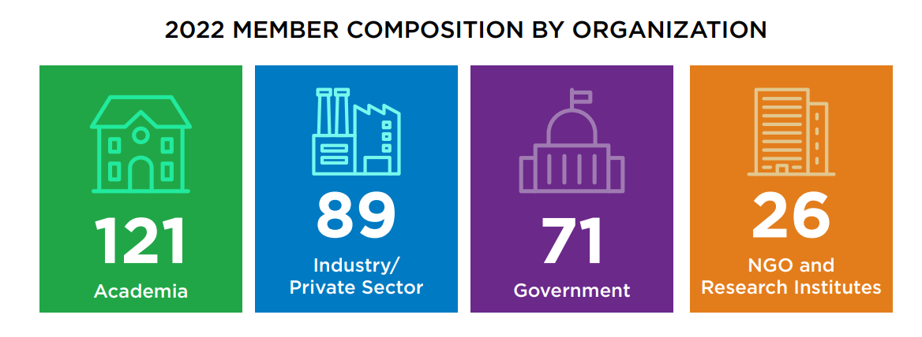
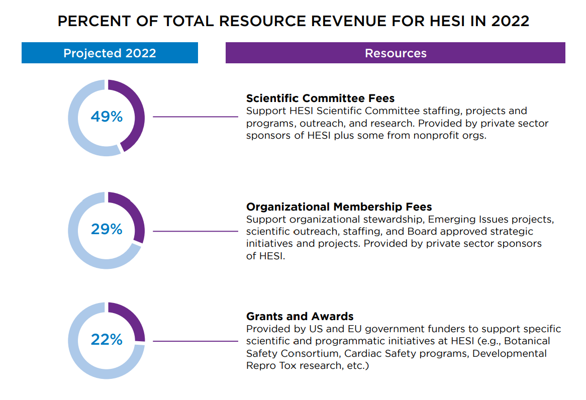
2022 Balance of Engagement & Resourcing

Slide 6
Why Engage with HESI?
Opportunity to collaborate with academic, regulatory, clinical, and other industry scientists working on issues that matter to your scientific portfolio
Exposure to global best practices, evolving drug/development safety issues and discussions, etc.
Opportunity to actively contribute to discussions and data generation/evaluation that impacts global safety assessment practices
Opportunity to leverage resources by pooling data, expertise, funding, and lab facilities across partner organizations
Opportunity to build scientific networks and professional development for your staff

Slide 7
HESI’s science is a key reference point for …
ICH S1, S7, E14, S5, S2, S8, S11, E14/S7B
OECD (Genetox, PBPK, Bioaccumulation)
Regulatory & research agency scientific strategy & resource evaluation (FDA, EMA, EPA, PMRA, ANVISA, PMDA, ECHA, European Commission and more)
Enhanced Efficiency & Accuracy in Safety Assessment
Regulators and govt research institutes seek HESI to help address contemporary challenges with expert input.
MOUs and grants from federal agencies to HESI to support HESI’s regulatory science research

Slide 8
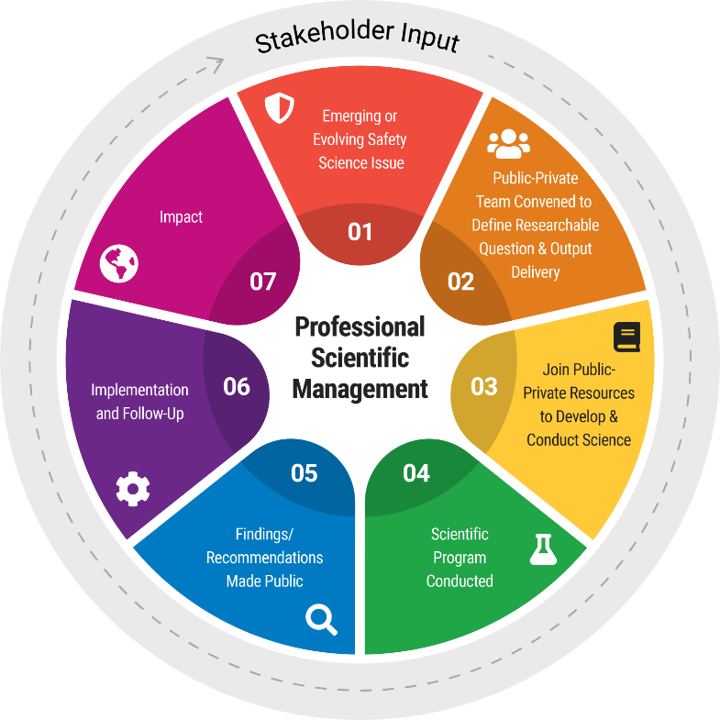
Facilitating New Science: Moving science from the idea stage to the implementation stage
The adoption of new programs & projects allows HESI to address the most relevant emerging science & serve as a contemporary resource for our stakeholders

Slide 9
More resources
HESI Operating Policies, available online at https://hesiglobal.org/wp-content/uploads/2022/02/HESI-Operating-Policies-approved-18-Jan-2022.pdf.
Public-Private balance (governance and at committee level) – HESI is not an industry group
Independence: generate science with the public benefit in mind, for improved human and environmental health
Scientific Integrity and Transparency
Data sharing: sharing of information about best practices in risk and safety assessment, analytical methodologies, nonproprietary mechanisms and biological/ecological systems, R&D challenges, etc.
Open, peer-to-peer discussion forum.
Joint publications (commitment to open-access)

Slide 10
HESI New Approach Methodologies Programs

Slide 11
New Approach Methodologies at HESI
Advancing the design and application of NAMs across chemical, drug, food, and consumer product safety (for human and eco applications)
Individual programs focus on specific questions

Slide 12
HESI NAMs Activities Addressing a Range of Focus Areas
Agrochemical, environmental chemical, consumer product safety
Safety of Therapeutics
Ecological Risk Assessment
Food safety
Transforming the Evaluation of Agrochemicals
RISK21
Biomarkers of Neurotoxicity
Developmental and Reproductive Tox
Genetic Toxicology
Emerging Systems Toxicology for the Assessment of Risk
PBPK models
Next Generation Ecological Risk Assessment
Botanical Safety Consortium
Biomarkers of Neurotoxicity
Cardiac Safety
Cell Therapy – Tracking, Circulation & Safety
Developmental and Reproductive Toxicology
Genetic Toxicology
Emerging Systems Toxicology for the Assessment of Risk
PBPK models
Targeted Protein Degraders
Next Generation Ecological Risk Assessment
Botanical Safety Consortium
Protein Allergens, Toxins & Bioinformatics

Slide 13
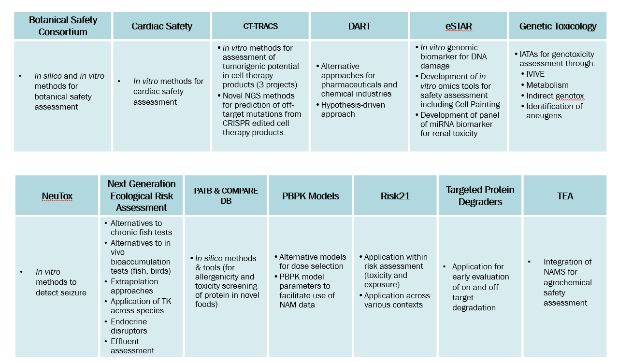
Robust Portfolio of NAMs Programs Across HESI Committees

Slide 14
Botanical Safety Consortium
Working to evaluate the suitability of assays for botanicals as complex mixtures.
Assays selected already have an established history for single chemical toxicity testing (e.g., Ames test, DevTox assay, voltage sensitive dyes).
Outcomes will include a toolkit of assays that can be used to screen for botanical-induced toxicity, shared learnings, advance of botanical safety field, and publications.
https://botanicalsafetyconsortium.org/

Slide 15
Cardiac Safety
Collaboration using data to complete a math model of heart rate and blood pressure changes.
This method can be applied to both animal and human data and has the advantage of using a model to detect subtle changes and understand earlier toxicity risk.
Stem Cell Chronic Study
Use human iPSCs to identify chronic treatment induced cardiotoxicty and build confidence in in vitro assays.
Assessing variability and reproducibility of manual and automated patch clamp platforms.
Coordination of manual and automated patch clamp studies to detect changes in 4 cardiac ion channels. The data will help fill gaps in the CiPA ion channel dataset as well as provide additional information on real-life variability of the model system.
Consortium Led Evaluation of Integrated Human-Relevant Approaches to Identify Drug Induced Cardiovascular Liabilities.
Coordination of the evaluation of novel assay platforms using human-based stem cells via pilot and validation studies. These will promote a better understanding of toxicity mechanisms and use in vitro studies to evaluate new drugs.

Slide 16
Cell Therapy – Tracking, Circulation, and Safety (CT-TRACS)
Digital droplet PCR assay for detecting residual undifferentiated iPS cells in iPSC-derived cell therapy products
Evaluate the precision, detection sensitivity and specificity of the ddPCR method, at an international multisite level.
Highly efficient culture (HEC) assay for detection of residual human pluripotent stem cells in cell therapies
Evaluate the sensitivity and interlaboratory variability of the HEC assay at multiple facilities according to ISO standards. [Watanabe et al. 2023. Regenerative Medicine https://doi.org/10.2217/rme-2022-0207]
Novel NGS methods for prediction of off-target mutations from CRISPR edited cell therapy products
Understand the frequency and location of CRISPR Cas9 off-target editing, via identification of double-strand breaks (DSBs); understand the mechanisms that underpin the formation of mutations caused by DSBassess applicability of the assays in a collaborative study
Soft agar colony-forming assay (SACF)/Growth in low attachment assay (GILA)
Multi-site study comparing the two assays aimed at detecting off-target editing mofidications to gene therapies that lead to malignant transformations
IL-2 project
Multi-site study of an assay used to assess the tumorigenic potential of modified T or CAR-T cells

Slide 17
Developmental and Reproductive Toxicology (DART)
Manuscripts highlighting case studies for application of NAMs
Hypothesis driven approach – describing a move away from the traditional approach to developmental toxicology testing towards a hypothesis-driven mechanism-based approach to testing
Use of NAMs in the pharmaceutical sector – describing current use of alternative methods and include a call to action to submit alternative methods data generated in regulatory submission packages as a means to increase regulatory confidence in the use of these methods
Use of NAMs in the chemicals sector – this manuscript will focus on the use of read-across and successful case studies wherein this approach was used and successfully accepted by the regulatory authorities
DARTable Genome project
The DARTable Genome is a New Approach Methodology which takes form as a predictive tool built from curated quantitative knowledge of DART molecular initiating events and the key events in the adverse outcome pathways they trigger.
Goal: Develop a DART Safety Screening Panel.
To test the validity of this model, the team has selected the well characterized teratogen, Retinoic Acid, to serve as the first case study

Slide 18
Emerging Systems Toxicology for Risk Assessment (eSTAR)
In vitro genomic biomarker for DNA damage
A four-site ring trial generating additional data on the TGx-DDI (TGx = toxicogenomics; DDI = DNA damage inducing) biomarker.
Development of in vitro omics tools for safety assessment including Cell Painting – OASIS Consortium
Generation of cost-effective integrated methods in support of a shift in chemical and drug safety decision-making from apical animal endpoints to in vitro testing and predictive toxicology methods.
OASIS will result in the development of predictive algorithms that integrate novel cell painting and transcriptomic data with existing in vivo animal/human data for hundreds of compounds.
Development of panel of miRNA biomarkers for renal toxicity
This panel could be used in in vitro models for screening or potentially from animal urine or other biofluids.
TgX-DDI biomarker is currently under review by the FDA as part of the FDA Biomarker Qualification program.
Pending the results of this final study, the marker is anticipated to gain FDA approval for optional use as added weight of evidence in the assessment of genotoxicity.

Slide 19
Genetic Toxicology (GTTC)
GTTC Working Group focused on in vitro methods for genotoxicity, and is examing in vitro methods through key aspects of genetic toxicology:
In vitro to in vivo extrapolation
Metabolism
Indirect genotoxicity
Identification of aneugens
SWOT analyses and case studies are being developed for each

Slide 20
Translational Biomarkers of Neurotoxicity
Working to characterize the predictivity of seizurogenic activity using MEA (multi-electrode array) technology
Improve translation
Use a novel in vitro method
Reduce animal use
Increase mechanistic understanding
Make earlier decision making/compound de-risking
A large, international, multi-site study completed on 12 compounds with known seizurogenic activity in both rodent and human stem cells.
To find a set of endpoints that are predictive of seizure
Data analysis ongoing

Slide 21
Next Generation Ecological Risk Assessment
Alternatives to chronic fish tests
A workshop is being planned for October 2023 with the goal of developing a roadmap to guide alternative strategies for assessing chronic toxicity to fish. The workshop will focus not only on using NAMs for animal reduction, refinement, and replacement (i.e., the 3Rs), but also on how they can improve our ability to ascertain chronic impacts.
Alternatives to in vivo bioaccumulation tests (fish, birds)
Bird: 3-year experimental study to investigate in vitro methods to study biotransformation of organic chemicals in birds. The results of the study will help with design of predictive avian bioaccumulation and biotransformation models.
Fish: An OECD IATA is being submitted to guide the collection, generation, evaluation, and weighing of several types of bioaccumulation data including leveraging new approach methods to better predict ecological effects from chemicals.
Extrapolation approaches
The EnviroTox database is a publicly available tool that can be used for comparison of existing in vivo data with data generated via new approach methodologies and for various extrapolation approaches by leveraging the filtering and calculation tools.
Endocrine disruptors
Currently used new approach methods that are regulatory accepted for EDC assessment published (https://doi.org/10.1002/etc.5584).
Investigating currently used in vivo tests, including performing historical control analyses.

Slide 22
Protein Allergens, Toxins, and Bioinformatics (PATB) & COMPARE Database
https://comparedatabase.org
COMPARE database: comprised of protein sequences of known allergens.
One of the many uses of COMPARE is for food safety assessment.
Identify cross-reactivity potential for novel proteins as previously sensitized individuals may be at risk for allergic responses to a food or protein source not known to cause allergy.
Identify proteins that may be related to a degree that enough structural similarity exists to warrant further experimental investigation into its potential to be cross-reactive.
Updated yearly released at the end of January.

Slide 23
PBPK Models
Weight of Evidence for TK
Goal: Develop guidance and case studies on using TK information in a weight of evidence approach to support dose selection in toxicity studies and aid interpretation of dose-response data for chemical risk assessment (e.g., dose dependent transitions)
PBPK model parameters to facilitate use of NAM data
Goal: Provide recommendations on using a PBPK model to conduct animal-to-human extrapolations, focusing on the challenge of selecting appropriate human values for chemical-specific parameters
Evaluation of the 90d dog study for agrochemical assessment (joint project between TEA & PBPK)
Key question: Under what conditions (context of use, chemistry) is a 90d dog study needed to inform human health risk assessment of agrochemicals?
Specifically, how can knowledge of PBPK (and modeling approaches) help address questions related to the utility of the 90d dog study
Involves analysis of existing in vivo data in addition to in vitro and in silico approaches

Slide 24
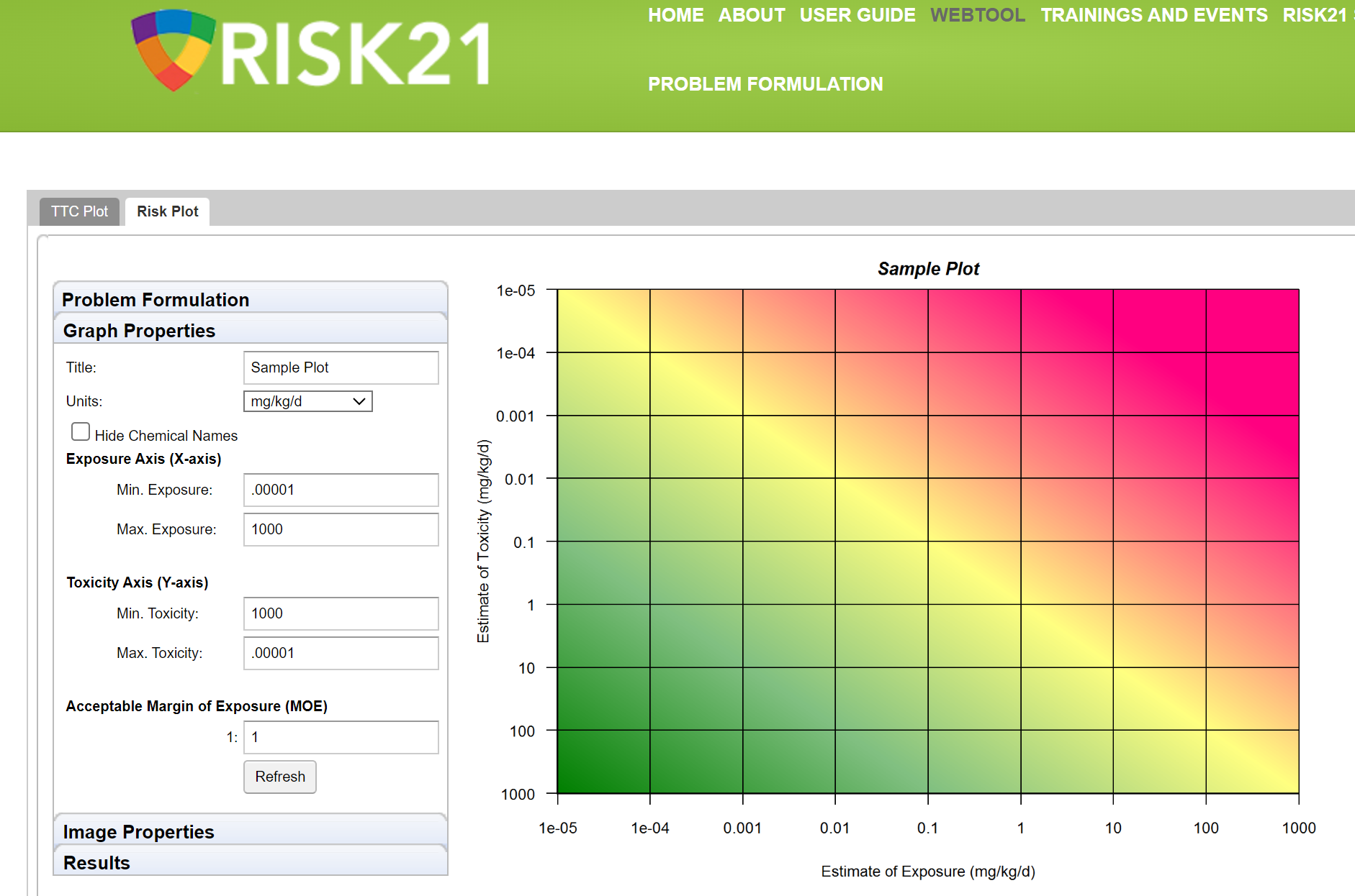
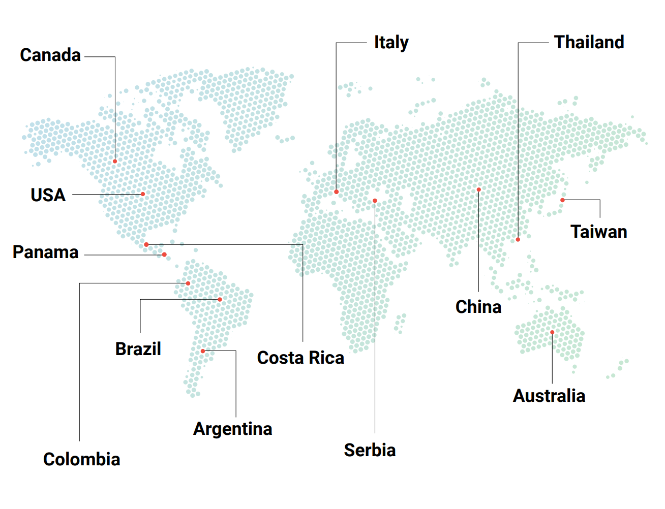
RISK21
https://risk21.org/
International Hands-On Case Study Workshops 2015-2023
Mission:
Harmonize the approach to how the world evaluates chemicals using a risk-based approach.
Problem-formulation based
Risk-based at each step of the process
Use of prior knowledge
Fit for purpose
Value of information
“Enough precision to make the decision”
Provide a framework that is flexible, transparent, visual

Slide 25
Targeted Protein Degraders Safety
Mission: To advance efficient and effective translational safety assessment to maximize the therapeutic potential of targeted protein degraders for patients, via an international network of multi-partite, multi-stakeholder experts
Exploring assays & models to evaluate safety of heterobifunctional degraders and molecular glues
Consideration of NAMs for early evaluation of on and off target degradation

Slide 26
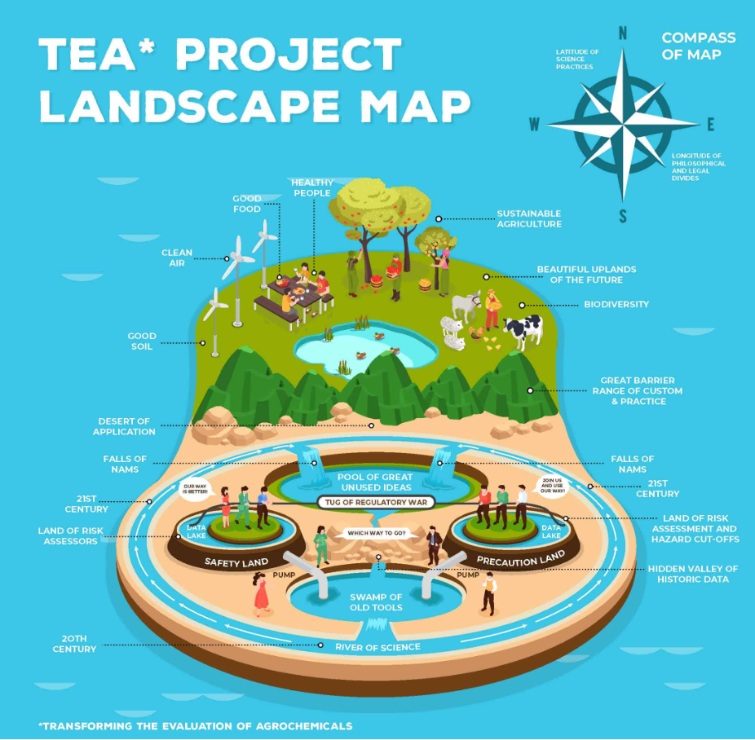
Transforming the Evaluation of Agrochemicals
NAMs Survey:
Developed and deployed among agrochemical companies (in the US and abroad) to inform which NAMs are typically used for R&D as well as product registration in different countries, and with what frequency.
The goal is to obtain some information on what NAMs may be more technologically ready for use or for regulatory acceptance than others, and to discuss how to best integrate them into the TEA roadmap.

Slide 27
https://view.storydoc.com/WA4xRj1b

Slide 28
Engage with HESI Programs!
For questions/more information:
Email hesigeneral@hesiglobal.org
Visit our website: https://hesiglobal.org/partner/partner-with-us/

