Slide 1
Nonclinical Efficacy & Safety Studies to Support Neonatal Therapeutics:
A Proposal
HESI Annual Meeting
June 10, 2015
Karen Davis-Bruno Ph.D (FDA/CDER/OND)
Melissa Tassinari Ph.D(FDA/CDER/OND/DPMH)
Jacqueline Carleer Ph.D (EMA PDCO/Chair NcWG)
Susan McCune MD (FDA/CDER/OTS)

Slide 2
Disclaimer: This presentation reflects the views of the speaker. It does not necessarily reflect FDA policy
This presentation originally given to
HESI DART Committee
April 22, 2015

Slide 3
The Problem
90% NICU drugs used off label
ADE 3X more likely
NICU patients have the highest medical errors and ADE rates
Efficacy
EU prematurity rates are 5-10%
USA prematurity rates (12%) worst of any developed country (131st in the world)
N Engl J Med 367:1279-81 (2012): Pediatrics 111(4):722-9 (2003): JAMA 285:2114-20 (2001)

Slide 4
CDER Neonatal Mandates Under FDASIA 2012
Specifically requires inclusion of neonates as a study population or justification for rationale not requesting a study in neonates in Pediatric Study Plans
Pediatric Review Committee requires neonatology members
Goal to increase the number of trials conducted in neonates-FDA report to Congress 2016 & every 5 years

Slide 5
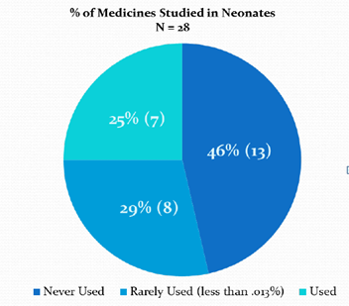

Neonates- How are we doing?
Studies must be clinically relevant
406 medicines studied in pediatrics only 28 (7%) were studied in neonates
These 28 drugs are rarely used in NICU
Priorities of clinicians, community, academicians, researchers, regulators, industry are not well aligned

Slide 6
Neonates Remain Therapeutic Orphans, Why?
Neonatal studies are regarded as not needed
Disease does not occur in newborns
  But it does in 1 year olds
Neonatal studies are too difficult?
  Ethical, emotional concerns
  Knowledge gaps in nonclinical models of neonatal diseases
  Endpoints do not apply or cannot be measured in newborns
  PK difficult to measure in newborns, need new formulations
  Study designs for pediatrics do not fit newborns e.g., smaller # patient population
  Should limit studies in newborns based on AE in adults, assuming they occur in neonates e.g., QTc?

Slide 7
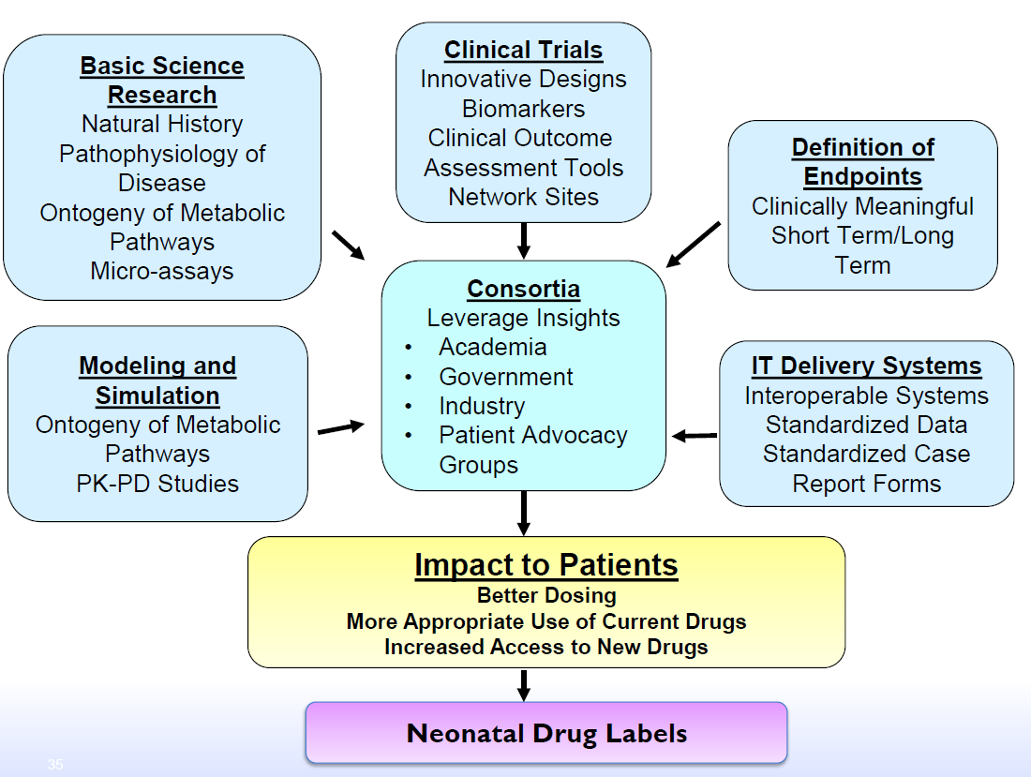
From: S.McCune 1st Neonatal Sci Workshop Oct 2014

Slide 8

Oct 2014 Agenda
Innovative trial designs
Trials that allow for extrapolation
Criteria for initiating trials in neonates
PBPK & PKPD modeling
Clinical outcome measures
Biomarkers
Structure of a neonatal consortium & voting on potential projects
Our proposal plans to explore nonclinical contributions to neonatal drug development

Slide 9
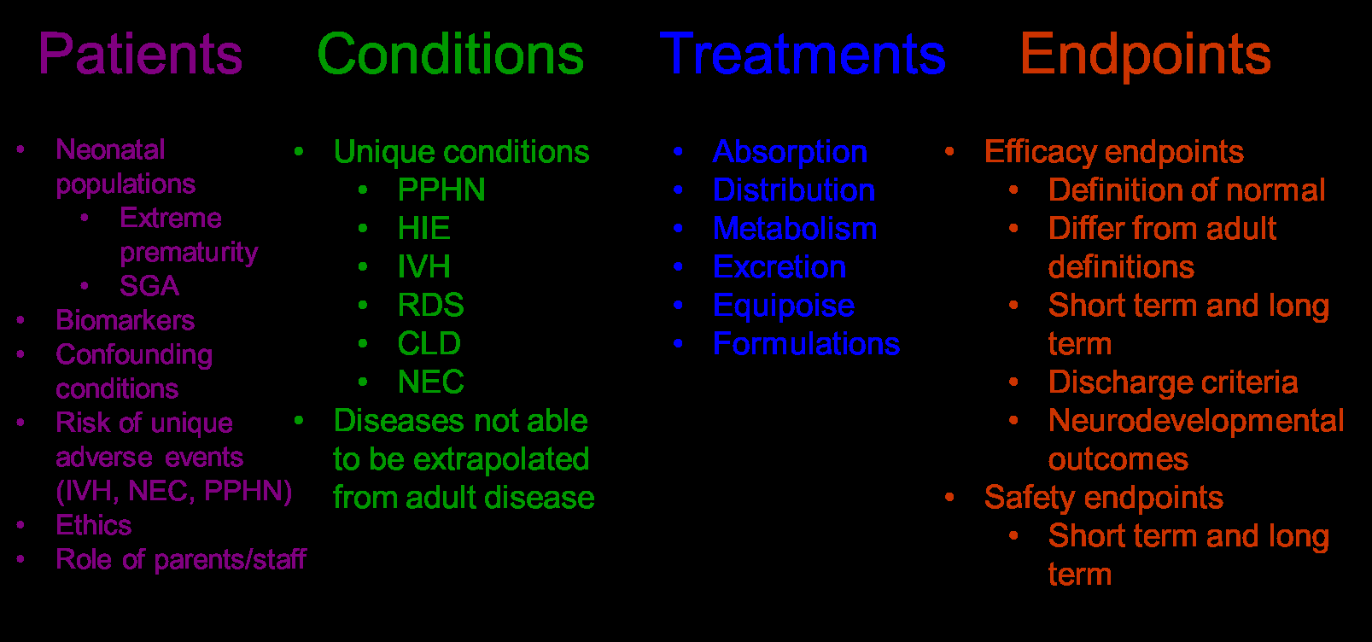
Neonatal Differences &
Clinical Trials
From: S.McCune 1st Neonatal Sci Workshop Oct 2014

Slide 10
Common NICU Conditions
Neonatal Brain Injury: Prevention and treatment of seizures, asphyxia, stroke, intraventricular hemorrhage (IVH) and white matter injury (WMI), leading factors in the development of neurodevelopmental impairment (NDI)
Neonatal Lung Injury: Prevention and treatment of Bronchopulmonary Dysplasia (BPD) and Persistent Pulmonary Hypertension of the Newborn (PPHN)
Neonatal Gastrointestinal Injury: Prevention and treatment of Necrotizing Enterocolitis (NEC)
Perinatal Infection: Prevention and treatment of bacterial and viral infections
Retinopathy of Prematurity (ROP): Prevention and treatment
Neonatal Abstinence Syndrome (NAS): Treatment of the withdrawal that results from in utero exposure to opiates
Prevention of preterm labor and delivery

Slide 11
Neonates: Unique Pediatric Population
Neonates & premies are a special pediatric subpopulation
Unique disease conditions
Significant physiological differences in organ system development & responses:
  Glucose, thermoregulation
  Neurologic, cardiopulmonary, immunologic
  Can’t extrapolate from adult/pediatric disease

Slide 12
Neonates require a global systems approach
Global Problem
Global Strategies
Highest proportion of off-label use in neonates
Lack of age adapted formulations
Delayed/lack of access to innovative meds
Knowledge gaps in developmental pharmacology
Limited clinical trials
Lack of suitable methodology & trial infrastructure for neonates
Limited funding for research on special peds population meds development
Failure of market driven forces
Multi-company/drug trials
Prioritization strategies for clinical trials to favor development
Innovative methodologies approach
Advocate participation & funding
Systems approach

Slide 13
Pediatric Planning in the Drug Development Process - Timing
Approved PIP required for MAA submission
PIP process begins
PIP modifications
Post Marketing Requirements
Phase 1
Phase 2
Phase 3
PMR
Submission & Review
Marketing Approval
EOP2
Agreed PREA requirements
Pediatric study plans
Within 60 days of meeting
PSP modifications
PIP: Pediatric Investigation Plan
MAA: Marketing Authorization Application
Written Request issued (BPCA)

Slide 14
How can nonclinical studies bridge the data gaps?
Identify relevant animal models for developmental stage or disease condition of premie/neonate
  What models are available?
  What aspect of the condition do they model effectively?
  What is the limitation of the model?
Provide knowledge of the pharmaco-dynamics during development
Assess long term effects of acute & chronic treatment on development & outcome

Slide 15
Non-clinical Studies for Safety Assessment
Safety pharmacology & pharmacodynamics (POC)
Pharmacokinetics/Toxicokinetics
  ADME: (absorption, distribution, metabolism, elimination)
General toxicology
Genotoxicity
Carcinogenicity
Reproductive toxicology
Local tolerance
Special studies
  Juvenile animal studies (case-by-case basis)
  Animal models of human disease?

Slide 16
JAS as a Tool
Juvenile Animal Studies are conducted when existing data from animals and humans are insufficient to support the proposed clinical trials in children
Direct Dosing
Juvenile animal studies
Repro Seg III
Repeat dose studies
birth
weaning
Indirect exposure

Slide 17
The General Design of Juvenile Study
  Relevant studies conducted in young animals of an age range developmentally comparable to that during which exposure would occur in humans
  Design emphasizes assessment of effects on growth and development, with other standard toxicologic endpoints included as appropriate for risk characterization
  Choice of endpoints informed but not defined by adult animal data
  Purpose is to identify age-related toxicity (i.e., unique developmental effects as well as differences in sensitivity)
  Standard histopathology to be conducted at end of treatment; more specific or expanded assessments of certain organs (e.g., brain) may be warranted
  Neurobehavioral and reproduction functions are usually assessed and any other relevant systems as deemed necessary

Slide 18
Animal Model Application to Human Premature/Neonate
Rodent, rabbits, guinea pig, dog, pigs, NHPs
Consider litter effects of multiparous species with data interpretation
Consider species/strain differences
Determine if model is similar to human for the specific system being modeled e.g.:
  Respiratory development similar across species
  Maturation of brain regions may differ across species
Consider relevance of animal model of human disease/condition
  What questions are we asking the animal model to address?

Slide 19

Multiple component approach
Global development
Neonates
Parents
Healthcare professionals
Health insurance agencies
Researchers
Industry
Policy makers

Slide 20
Proposal for a
Multidisciplinary Working Group
Using a multi-discipline group e.g.: neonatologists, teratologists, researchers, regulators
Identify different initiatives to avoid duplication
Identify major gaps in pre-term & term neonates drug development (disease vs model)
Identify neonatal animal models of human disease
Address how to best leverage neonatal nonclinical models to support safety and POC for human neonatal disease
  Extrapolate lessons learned pediatric only or 1st in pediatric development programs
Develop relevant study designs & data that can be obtained from nonclinical models

Slide 21
Mutual Aims
Neonate Proposal
ILSI-HESI DART
Publish review of expert group’s analysis
  Explore relevance & modifications of neonatal nonclinical models of human neonatal disease
Workshop
  Bring together industry, academia,neonatologists, & regulators to move the agenda forward on behalf neonates/premies
Develop consensus on appropriate use of toxicity data for human
Initiate activities to advance DART
Provide a forum for scientists can exchange information

Slide 22
Acknowledgement
Karen Davis-Bruno PhD (FDA/CDER/OND)
Melissa Tassinari PhD (FDA/CDER/OND/DPMH)
Jacqueline Carleer PhD (EMA PDCO/Chair NcWG)
Susan McCune MD (FDA/CDER/OTS)
Thank you

